Slide 1
MAT 3749
Introduction to Analysis
Section 2.1 Part 3
Squeeze Theorem and Infinite Limits
http://myhome.spu.edu/lauw

Slide 2
Major Themes
Introduction to proofs in the context of calculus 1
Make sure future teachers to have a better understanding of calculus 1
Look at (rigorous) ideas in analysis which can be extended to more advanced math

Slide 3
References
Section 2.1

Slide 4
Recall 0.1.3 Lemma 2

Slide 5
Lemma 2 (Expanded)

Slide 6
Preview
Squeeze Theorem
One-sided Limits
Limits at Infinities
Infinite Limits

Slide 7
Squeeze Theorem

Slide 8



Squeeze Theorem
$$y$$
$$a$$
$$x$$

Slide 9

Squeeze Theorem
$$y$$
$$L$$
$$a$$
$$x$$

Slide 10
Squeeze Theorem
$$y$$
$$L$$
$$a$$
$$x$$

Slide 11
Squeeze Theorem
$$y$$
You will see
this type of
idea over and
over again.
$$L$$
$$a$$
$$x$$

Slide 12
Example 1

Slide 13
Example 1

Slide 14
Example 1
We cannot apply the limit laws since
DNE (2.1.1)

Slide 15
Example 1
Make sure to quote the name of the Squeeze Theorem.

Slide 16
Analysis

Slide 17
Proof

Slide 18
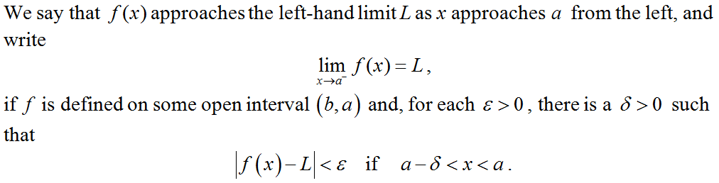
One-sided Limits

Slide 19
Common Notation

Slide 20
Consistency…

Slide 21
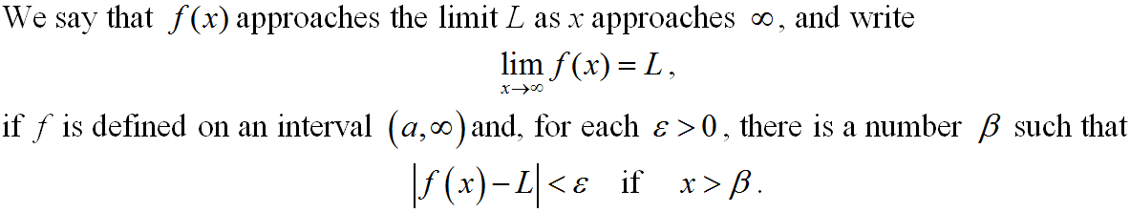
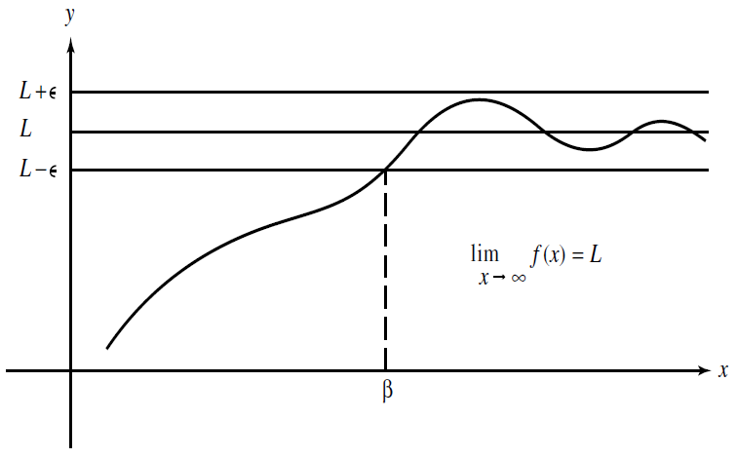
Limits at Infinities

Slide 22
Limits at Infinities
It can be shown that (most of the) limits laws remain valid for limits at infinities.

Slide 23
Example 2
Use the e-d definition to prove that

Slide 24
Analysis
Use the e-d definition to prove that

Slide 25
Proof
Use the e-d definition to prove that

Slide 26
Infinite Limits
y
The left-hand limit DNE
Notation:
y=f(x)
is not a number
x
a

Slide 27
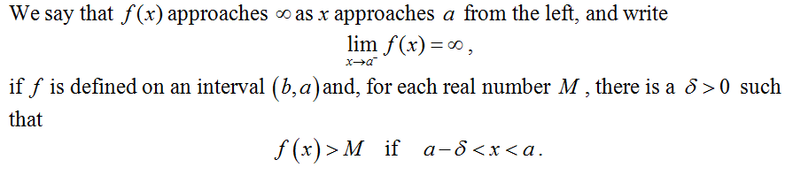
Infinite Limits

Slide 28
Lemma 2 (Expanded)

Slide 29
Example 3
Use the e-d definition to prove that

